Slide 1
Suburban Analysis for Business Opportunities in Chennai, TN.
Surya Prasad S

Slide 2

Meet George.
George is looking to expand his shop, Weasley’s Wizard Wheezes, in Chennai, India.
But the problem is, he is completely new to the place, and doesn’t know where to set up shop.

Slide 3

What places should he look for?
Chennai is a growing metropolitan city in South India. With that much growth and expansion, comes the need for services as well.
The problem lies within searching for suitable places for expansion. Places with similar services would only pose as a threat for new business ventures, and it would be difficult to rival a well-established vendor in the area.

Slide 4
But what would we do?
Manually scouring major competitions, tallying the different stores and such is tiring to the individual.
Hence, it would be prudent to automate this using available data, and get a meaningful result out of it.
We can build a Clustering Algorithm that can group places with similar vacancies together and give out lists of places that our potential shop owner can then capitalize on. A top 10 list would be precise and crisp.

Slide 5
Who needs to see this?
Here, the target audience is anyone who wants a group of venues similar to the venue that they've queried. This could be small businesses, large corps looking to expand, food chains, or an evening jogger looking for a change of pace, but in similar surroundings.

Slide 6

FourSquare API
FourSquare returns nearby venues and places of interest, given the location or a search query.
The API is utilized to obtain the venues nearby, which makes it possible to obtain the venues.

Slide 7
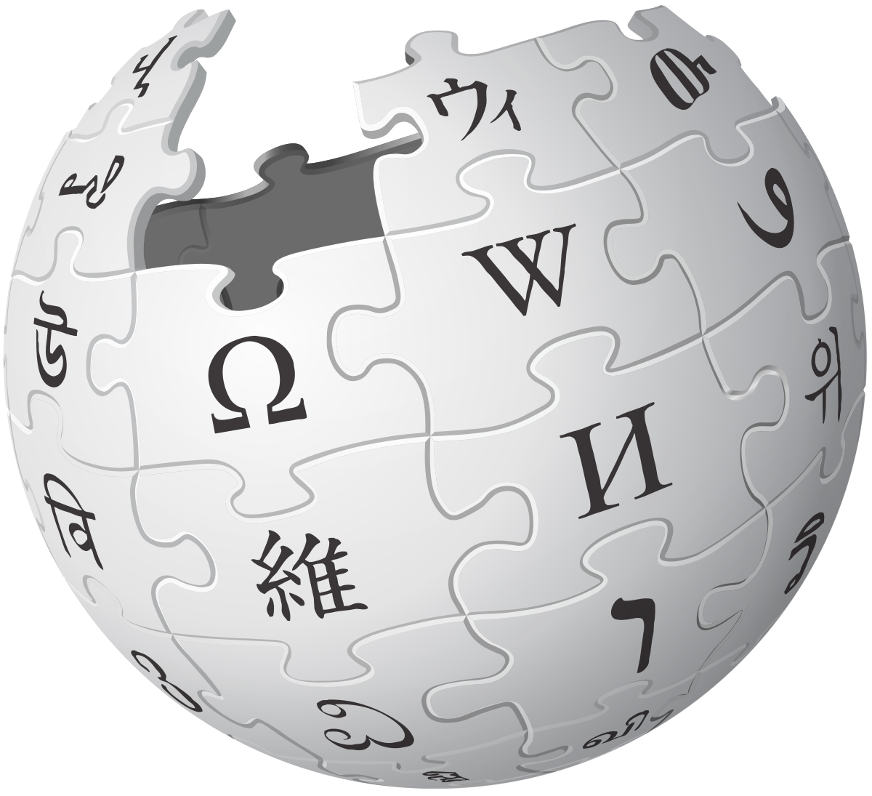
The Data was scraped from Wikipedia.
It contained the different suburban areas of Chennai.

Slide 8
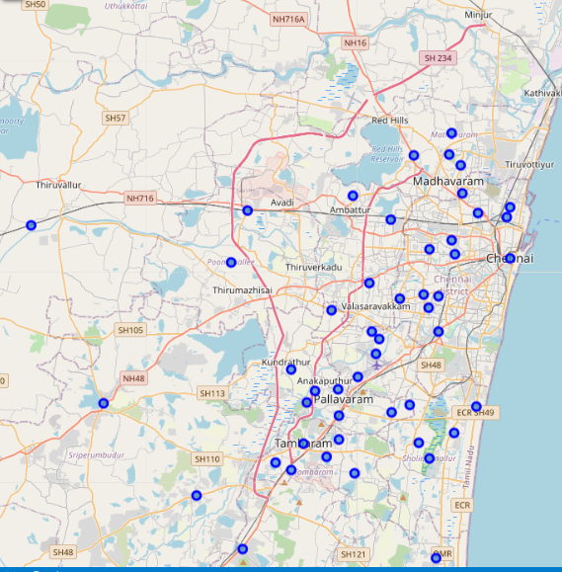
Data Wrangling
The data was further processed so that the Latitudes and Longitudes were obtained before passing it onto the API for venue retrieval.

Slide 9
The Model
With the venues retrieved, we try to find venues similar to the queried venue. To accomplish this, we cluster the data together and pick the ones in the same cluster as the queried type.

Slide 10
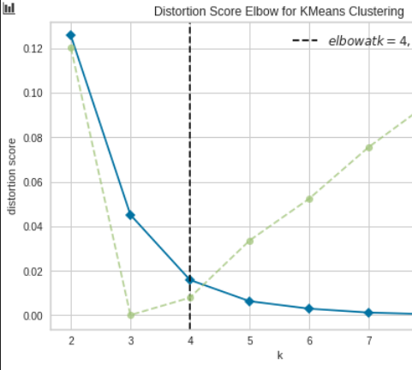
K-Means Clustering
The algorithm used is the K-Means Clustering Algorithm. Before we can start clustering, we need to specify the number of clusters beforehand. The method to ascertain that is used, and the suitable value is highlighted.

Slide 11
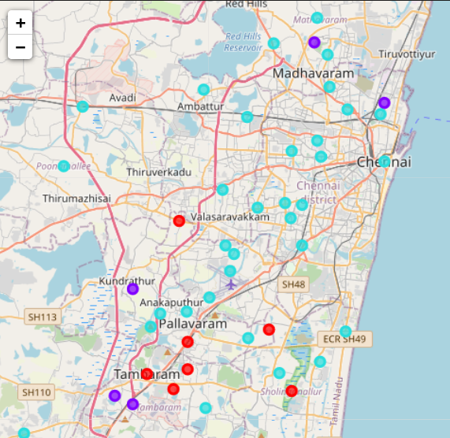
The data is then clustered, and the visualization is shown, with the desired cluster marked in red.

Slide 12
There you have it!
Even though metrics like these are, to a large extent, too vague to be completely relied on to use in a business venture, they definitely are of a huge help to eliminate places which already have a service available. The user benefits hugely from this, and can utilize his resources and time better, in his search.
If we were to improve on this, we would require data for the different preferences of people, such as distance, consumption levels and such. But that is beyond the scope of this project, but exists, nonetheless.

Slide 13
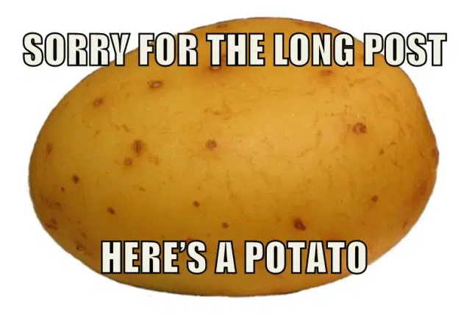
Thanks for your Interest!

